Slide 1
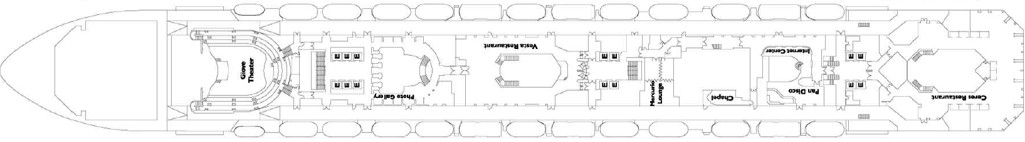
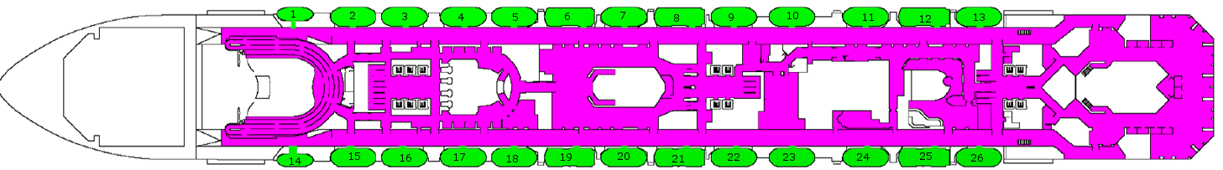
Modeling of a passenger ship evacuation
project and presentation by
Schmid Fabian, Raphael, Reber Andreas, Eugster Manuela

Slide 3
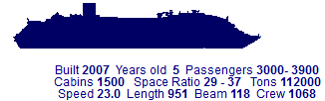
Abstract
Costa Serena
Introduction and Motivation
Model
Implementation
Results
Discussion
Outlook
Notes:
short view over the project…

Slide 4
Model and Implementation
Notes:
…some problems, how we solved them

Slide 5
bottlenecks
Notes:
where they are, what problems occur because of them→clogging agents, how we did (not) solve them..how they could be solved, pictures!!

Slide 6
clogging agents

Slide 7
stairs
Notes:
andreas: how we modeled the stairs, the problem and conecept behind it…ideas how to solve them better ( code that cheks if there is already an agent at stair below /above or not…only a limited number of agents allwoed in stair area…others wait …..)

Slide 8
results
Notes:
show one comparision→ added stairs/standard….

Slide 9
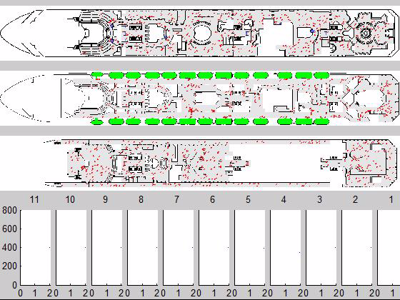
standard -ship deck simulation
Data:
floors: 11
exits: 26
capacity: 180
agents per floor: 400
timestep: 0.02 s
meter per pixel:
0.161
x
Number of agents on floor x
time

Slide 10
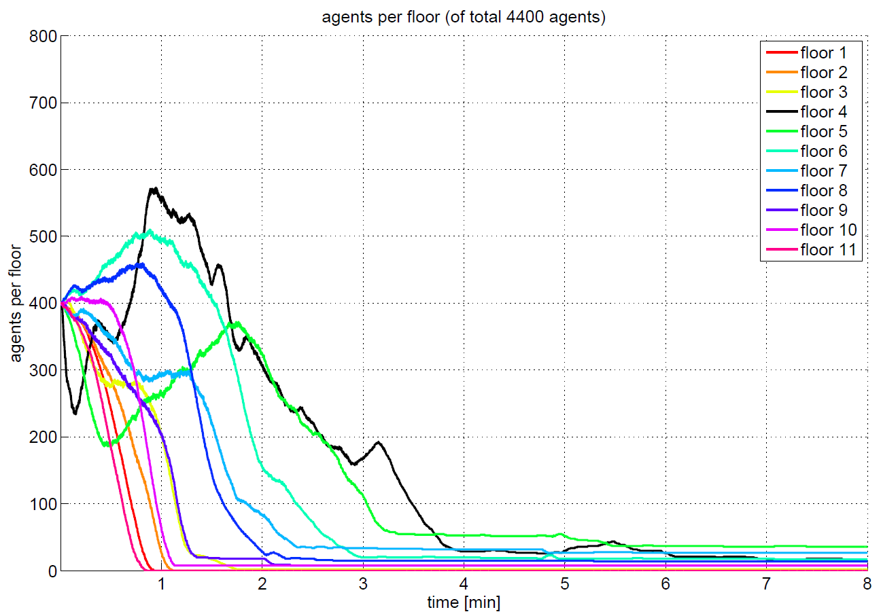
standard

Slide 11
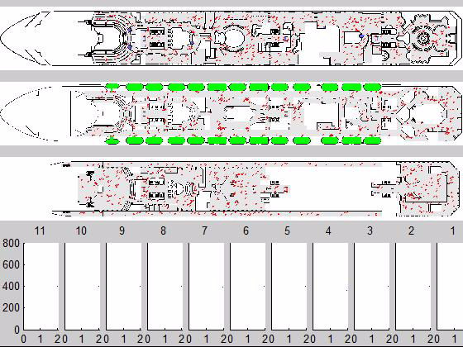
added stairs -ship deck simulation
Data:
floors: 11
exits: 26
capacity: 180
agents per floor: 400
timestep: 0.02 s
meter per pixel:
0.161
x
Number of agents on floor x
time

Slide 12
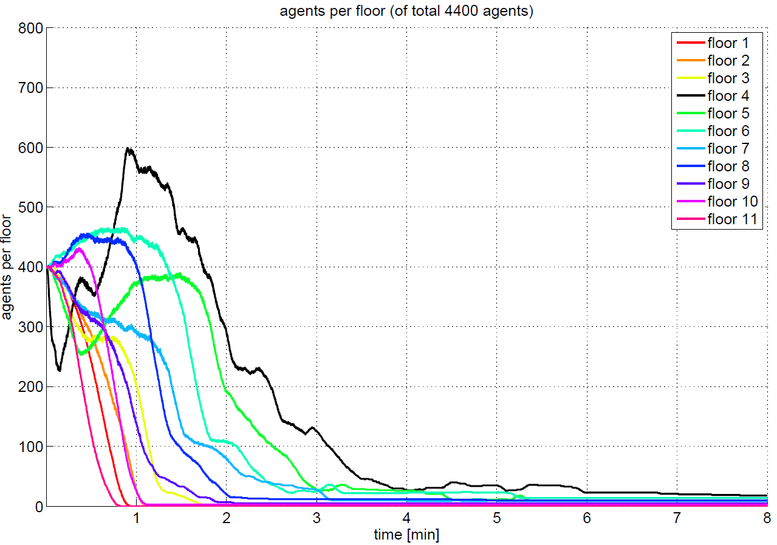
added stairs

Slide 13
standard
added stairs

